Slide 1
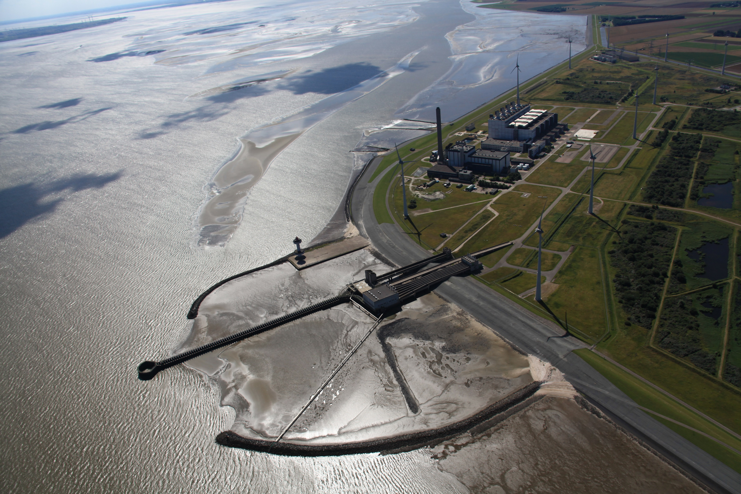
Welcome to the Eems Power Plant
Safety instructions for our own employees and contractors

Slide 2
Safety instruction
Following this presentation, your knowledge will be tested.

Slide 3
Acces to the location
Regular checks, including alcohol tests and visitations, will be performed
Report to the security office
You will receive a personal acces pass for the location
Use this pass to check in and out
Always carry this visitor’s pass with you
Report to your contact person of ENGIE on location
When checking in, an alcohol or drugs test may be carried out. At our location, the standard is 0,00%!
Upon leaving the location, the security officer may perform a visitation of your bag and/or vehicle

Slide 4
Fire or accident
Keep calm and take care of your own safety first
In case of a fire or accident, call the Emergency number:
+31 (0)88 769 22 22
In case of a fire or accident, make sure to mention:
Your name and telephone number
The location Eemscentrale
The exact position of the fire or accident
The nature and seriousness of a fire or accident
The number of victims

Slide 5
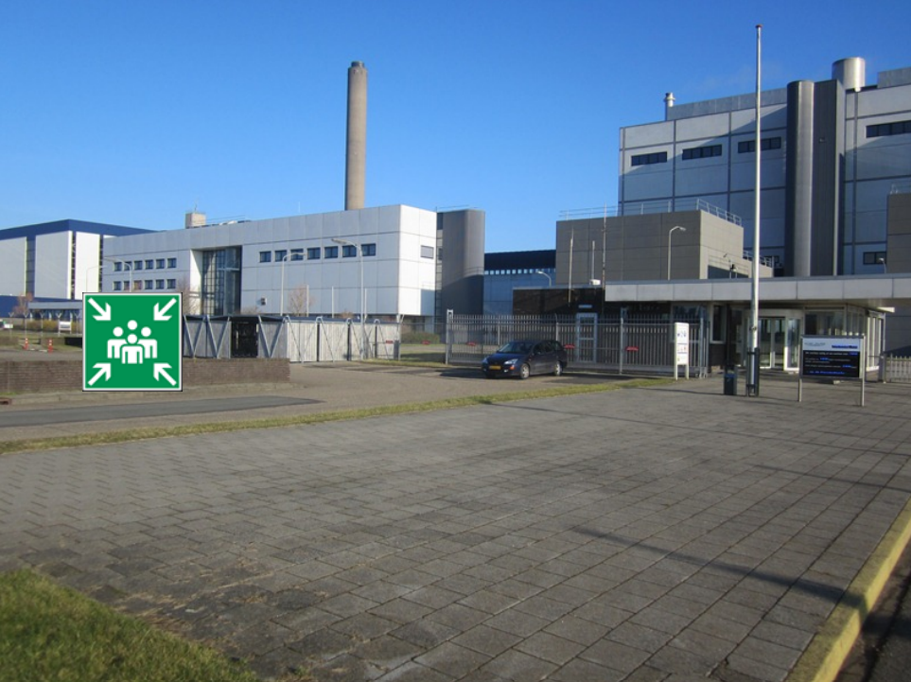
Assembly point in case of evacuation
Follow the instructions given by the person accompanying you and the Emergency Response Officer
Evacuation alarm: Slow Woop
Assembly point is located outside the security office

Slide 6
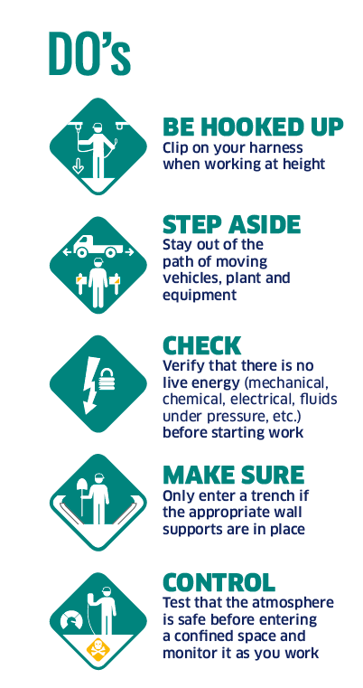
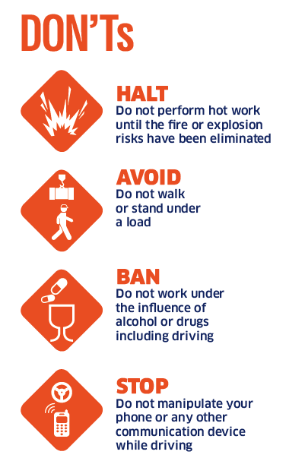
Life Saving Rules
Failure to comply can lead to serious accidents
Our standard is 0,00%!

Slide 7
Traffic
The road traffic act applies to the location
You are not allowed to enter the location with your vehicle until the security officer has given
you permission to do so
Use the parking pass that has been provided by the security officer
Always drive at a safe speed, maximum 15 km/h
Always give right of way to cyclists and pedestrians
Do not park in front of exits and fire extinguishers
Only park in locations indicated by a P sign

Slide 8
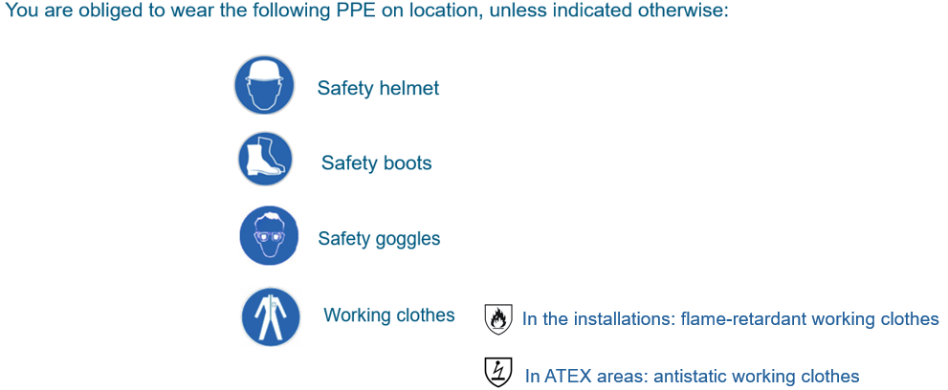
Personal Protective Equipment: PPE
Always check whether the PPE provides the correct protection

Slide 9
Additional PPE (as prescribed on the work permit)
Always use the addionally prescribed PPE
You are obliged to wear the following PPE, unless indicated otherwise:
Hand protection
Breathing protection
Safety harnes
Hearing protection
Face shield

Slide 10
Work permit
The work permit serves your safety and that of others
Working on location is only permitted with a work permit specifically pertaining to the activities concerned
The work permit is issued by your Intervention Officer (in Dutch: Interventie Verantwoordelijke, or IVV-er)
The work permit contains the most important instructions regarding the execution of the work
If the work permit is not clear, make sure to ask clarification!
Make use of the PPE prescribed on the work permit

Slide 11
LMRA (Last Minute Risk Analysis)
If ‘No’ or in doubt → STOP! Contact your supervisor immediately to discuss the situation
Check before starting each new job and after a break:
Is it clear what kind of work is expected of me?
Am I sure what installation part I have to work on?
Is my workplace safe and clean?
Is the work permit discussed with me?
Do I know the risks of my work?
Are system components safely in accordance with the work permit? Did I check that?
Are safety measures in accordance with the work permit?
Is work equipment and personal protective equipment (PPE) approved and suitable for my work?

Slide 12
Safety notifications
The safety notifications have been provided for you
Hazardous area (activities, lifting of loads, etc).
Do not enter without permission!
Danger of bumping, falling, tripping, radiation.
Do not enter without instruction!
Do not enter without permission!
Risk of explosion.
Do not enter without instruction!
Magnetic field.
Do not enter without instruction!

Slide 13
Overview danger symbols
Make sure you are aware of the risks of the hazardous substances
Flammable Gasses under pressure
Harmful or irritating Hazardous to the health in the long term
Corrosive (Highly) Toxic
Hazardous to the environment Oxidising
Explosive

Slide 14
Safety awareness, order and neatness
Notify your contact person of any unsafe situations and special circumstances
Only work on approved scaffolding (see inspection date)
Cordon off wall and floor openings with scaffolding or fencing
Immediately notify your Intervention Officer (IVV’er) of any oil leakages and any materials
containing asbestos or ceramic fibres observed
Keep fire extinguishers, emergency exits and escape routes clear
When interrupting your work – for breaks or at the end of your shift – make sure to clear all waste and
leave the workplace neat and tidy
Avoid tripping hazards by keeping the workplace and aisles free from materials
Deposit waste, properly separated, in the designated waste containers

Slide 15
Zero Tolerance
We address each other about unsafe behaviour
If you do not observe the rules, this will have serious consequences
The location makes use of camera supervision and surveillance officers to register any transgressions
The objective is strict enforcement of the safety regulations
In case of violations, we make use of yellow and red cards
A red card, for example, is given in case of alcohol or drug use. Our standard is 0,00%!
When a red card is given, the contract employee will be removed from the location immediately. In addition,
access will be denied to all locations of ENGIE

Slide 16
Location rules for your own safety
We will be happy to learn of your views regarding point of improvement for our location
It is prohibited to enter the location while under the influence of, or in the possession of,
alcohol and/or drugs. Our standard is 0,00%!.
Smoking is only permitted in the designated smoking areas
Always notify your supervisor or contact person of ENGIE when you encounter any
unsafe situation, accident of near-accident
The making of recordings (photographs, videos) is only allowed after permission by an
ENGIE officer in charge

Slide 17
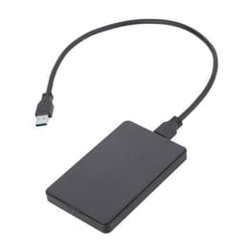
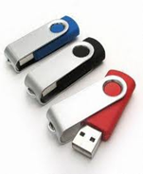
Use of USB sticks or hard drives
Do not connect any device to the system of this location
It is not permitted to use USB sticks, hard drives or any other storage device
to retrieve or transfer data from an industrial system

Slide 18
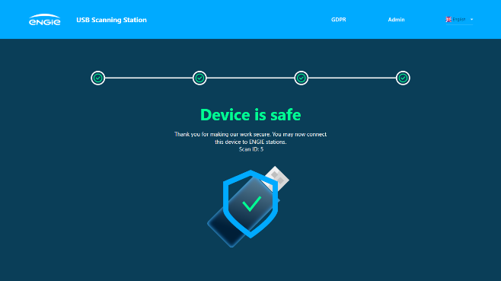
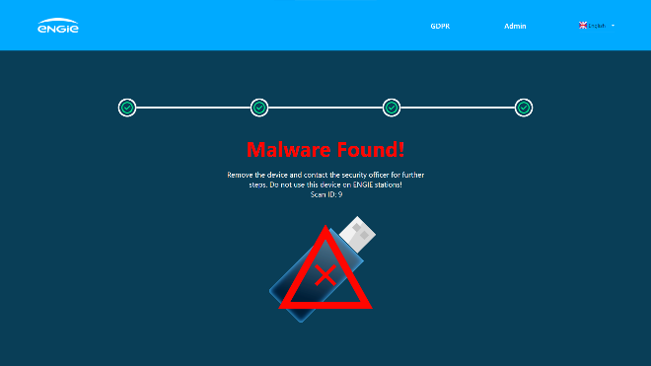
Scanning of USB sticks or hard drives
Scan any external device every time before use
Preferably use a device that is only used for this ENGIE location
The location can provide you with an USB stick
In case there is no other solution than the use of USB sticks, hard drives
or any other storage device, contact your ENGIE contact person
Each time before connecting a device to the system on this location, the device has to be scanned by
your ENGIE contactperson.
This must be done using ENGIE scanning equipment.
The scan should show that no viruses have been detected.

Slide 19
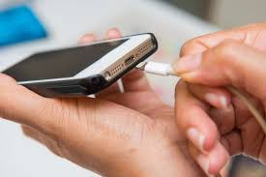
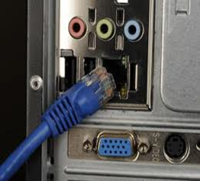
Use of external devices
Always contact your ENGIE contact person or cybersecurity person of the location
It is not allowed to connect external devices, such as laptops, to systems on the location
If this is necessary for your work, always consult your ENGIE contact person
Ask if ENGIE has a laptop available to carry out the work
If this is not the case, ENGIE has the right to assess your laptop on a number of points:
1. The device is up to date in terms of operating system
2. The validation of the virus definitions is less than 2 days old
3. The validation that the device is recently scanned and free of malware

Slide 20
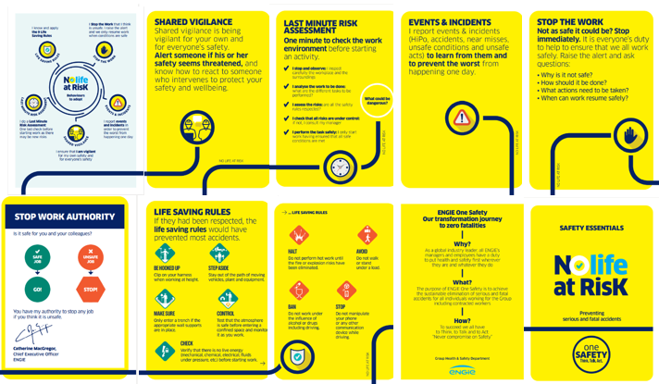
We work safely … or do not work at all!
We speak to each other about unsafe behavior
It is very important to us to make sure you return to your home safe and sound!
Enjoy working at our location.

